Slide 1
NoSQL Trends and Applications
By: Peter Keres, Tyler Yann, Michael Farmer

Slide 2
What is NoSQL?
NoSQL database system encompasses a wide range of database technologies
This data can store structured, semi-structured, unstructured and polymorphic data
Carl Strozz introduced this concept in 1998
Non-relational DMS
Stores data in a schema-less fashion
Easy to scale
Designed with web applications in mind
NoSQL database stands for "Not Only SQL" or "Not SQL."

Slide 3
The difference from SQL
NoSQL retrieves data faster
Can easily store huge amounts of data
Create databases without a detailed schema

Slide 4
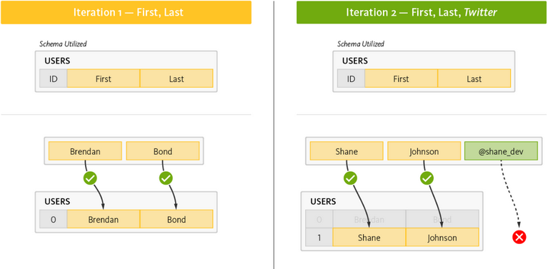
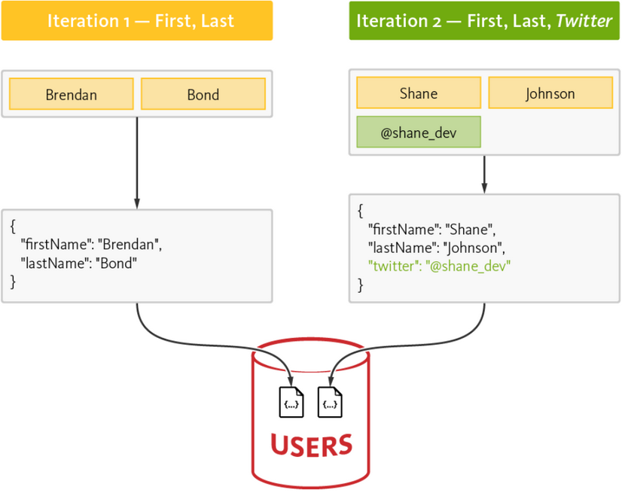
How data is stored in SQL vs NoSQL

Slide 5
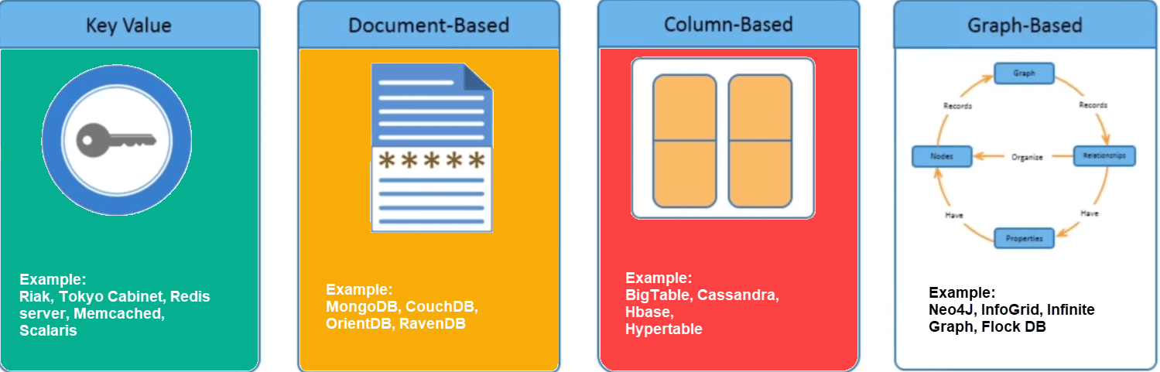
Different Types of NoSQL

Slide 6
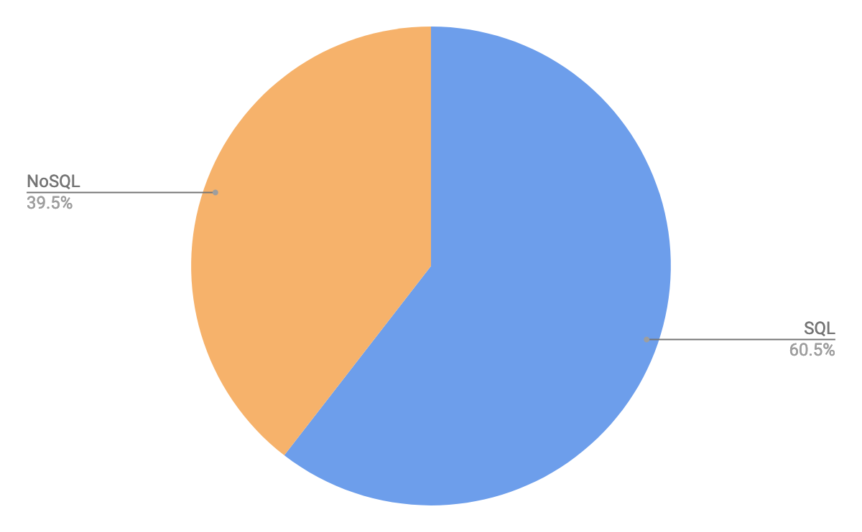
How Many Use NoSQL Today?
SQL has had a large lead over the non-relational alternatives for decades
NoSQL is gaining more popularity

Slide 7
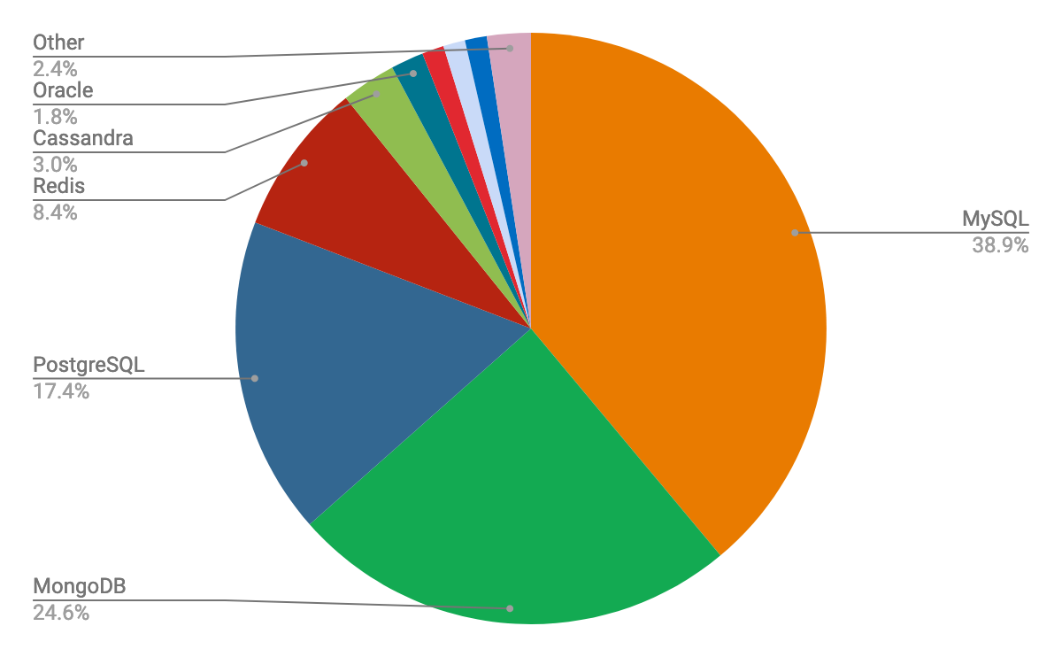
Popular Databases in Use
MongoDB, Redis, and Cassandra are prominent NoSQL databases

Slide 8
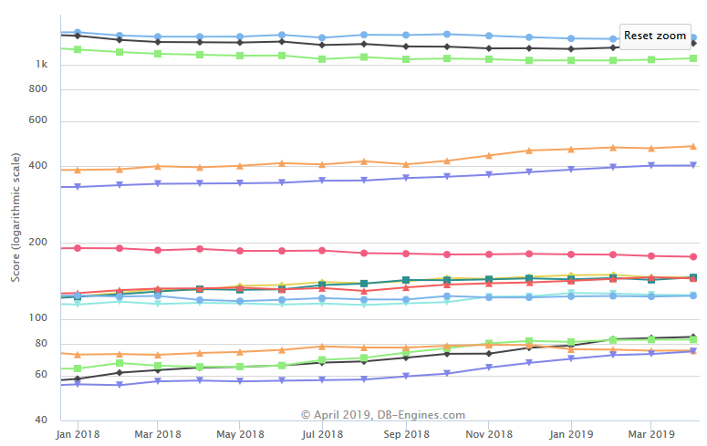
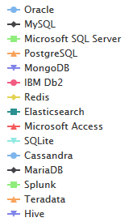
Most Popular Databases

Slide 9
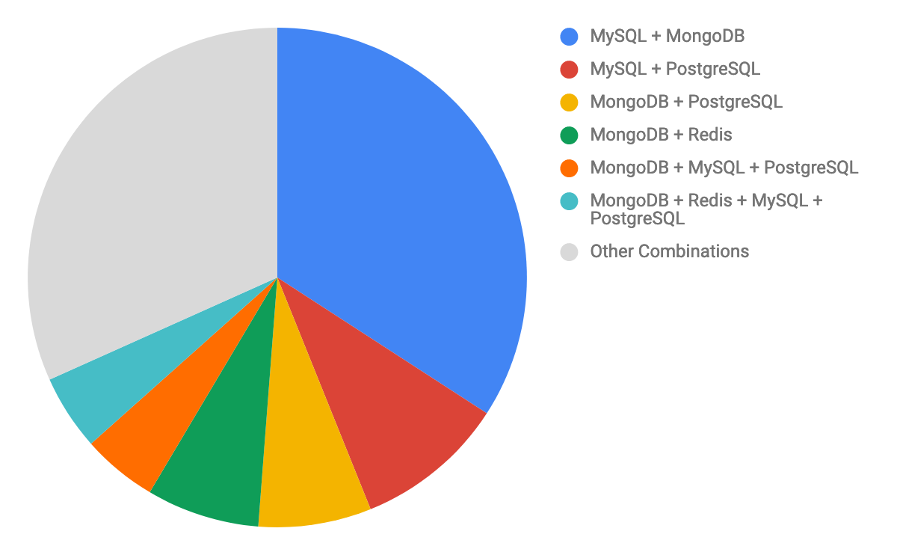
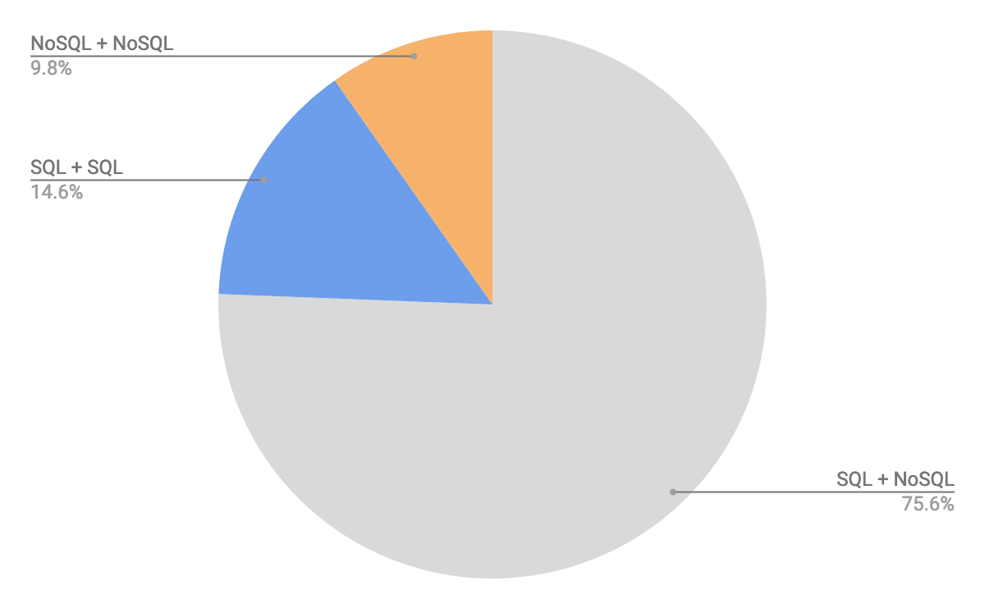
Most Popular Combinations
The tech giants, Facebook, Google, and Twitter use a combination of both NoSQL and SQL as well

Slide 10
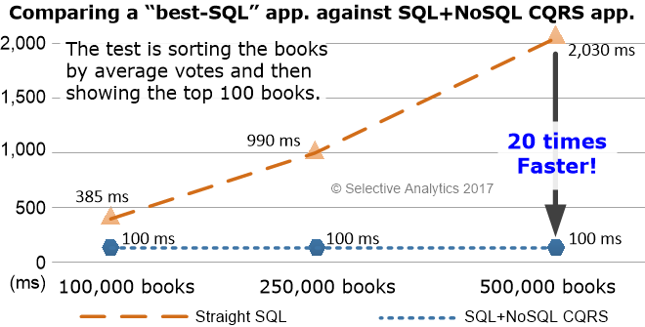
The Combination in Action

Slide 11
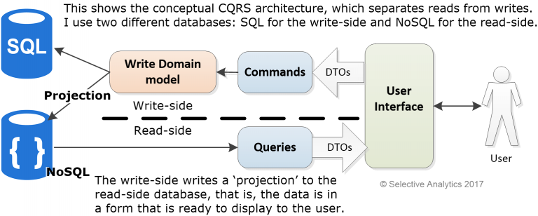

Slide 12
Two For the Price of One
CrateDB
Distributed SQL database that is built on top of a NoSQL foundation
CrateDB 1.0 released in December 2016
CrateDB 2.0 released in May 2017

